Slide 1
Analysis of OKCupid Data
Machine Leaning Fundamentals:
Eliot Austin-Forbes
04/07/2020

Slide 2

Questions
We will explore models for predicting an individual's drinking habits.
Key techniques used will include:
K Nearest Neighbor Classifiers
Multiple Linear Regression
Support Vector Machines (SVM)

Slide 3
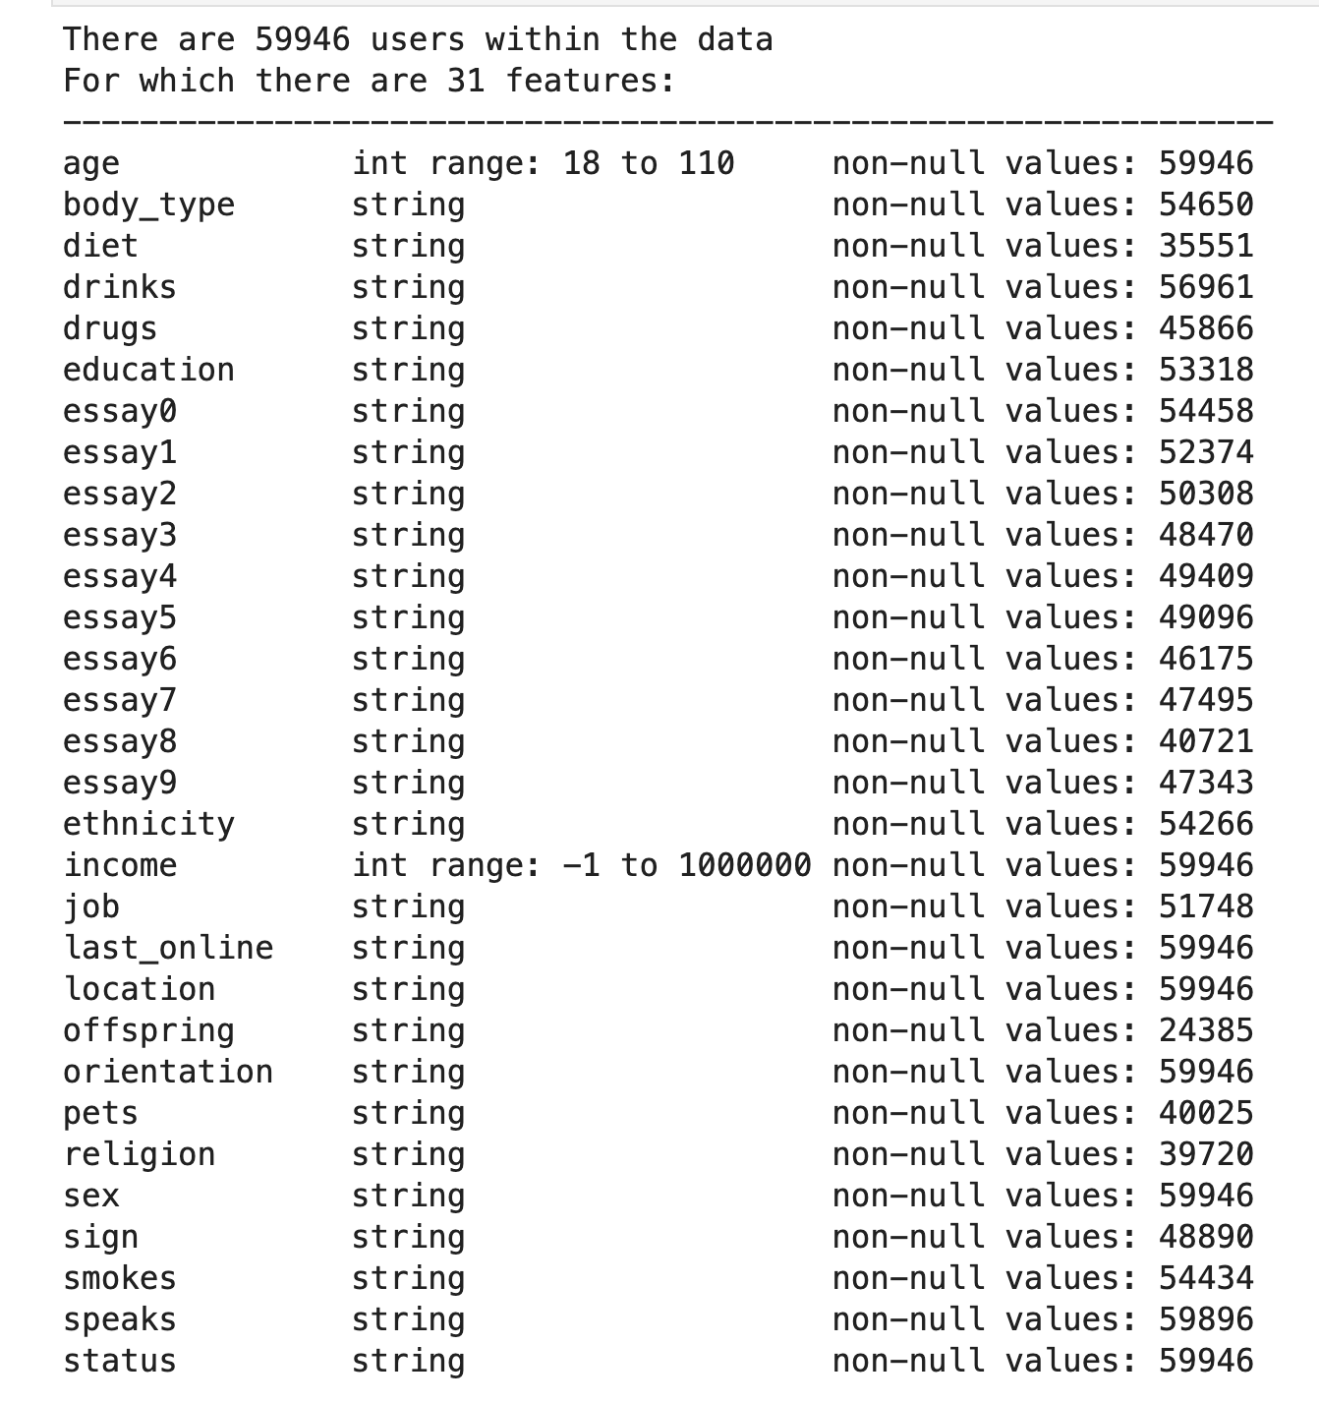
Exploration of Data
This project is based on approximately 60,000 user profiles.
Potential issues:
Most users state their drinking habits as 'often'

Slide 4
Sample Code: CSV Analyzer
import pandas as pd
import numpy as np
from matplotlib import pyplot as plt
# Load df:
df = pd.read_csv('profiles.csv')
# List of column labels
column_names = df.columns.values
# Generate overview of csv data, including object types and number of non-null values:
def csv_overview(df, column_names):
print(f'There are {len(df)} users within the data')
print(f'For which there are {len(column_names)} features:')
dash = '-' * 63
print(dash)
for i in range(len(column_names)):
if df.dtypes[column_names[i]] == int:
print( '{:<15}{:<25}{}'.format(column_names[i],
f'int range: {min(df[column_names[i]])} to {max(df[column_names[i]])}',
f'non-null values: {df[column_names[i]].count()}'))
elif df.dtypes[column_names[i]] == 'O':
print( '{:<15}{:<25}{}'.format(column_names[i], 'string', f'non-null values: {df[column_names[i]].count()}'))
# Execute
csv_overview(df, column_names)

Slide 5
Exploration of Data
A cursory analysis allows selection of some data for correlating to drinking habits.
Typical personality profiles may sometimes be condensed to the seven labels highlighted left.
Note that some features such as income, despite having a high number of non-null values, are primarily populated with an arbitrary value (-1) to signify no user input. Such features are not useful for analysis and so have been purposefully left out of selection.

Slide 6
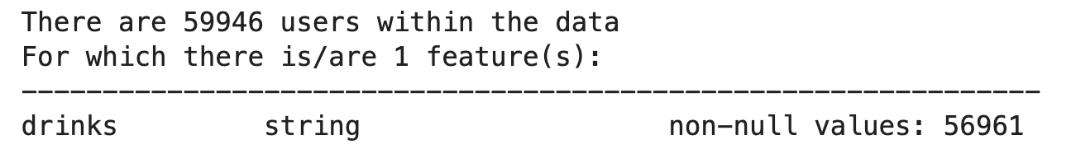
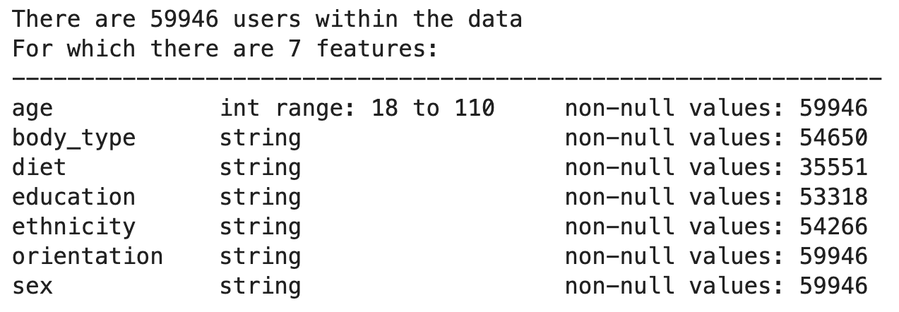
Exploration of Data
Labels
Features

Slide 7
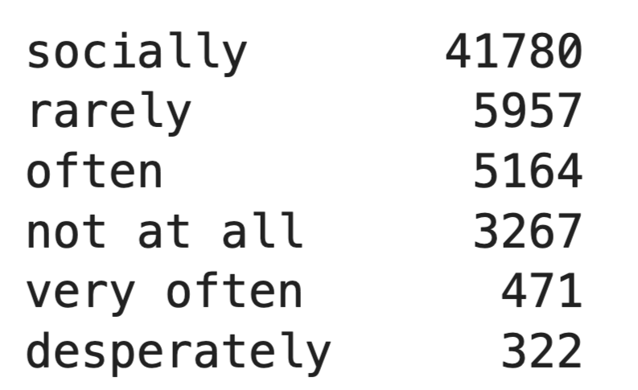
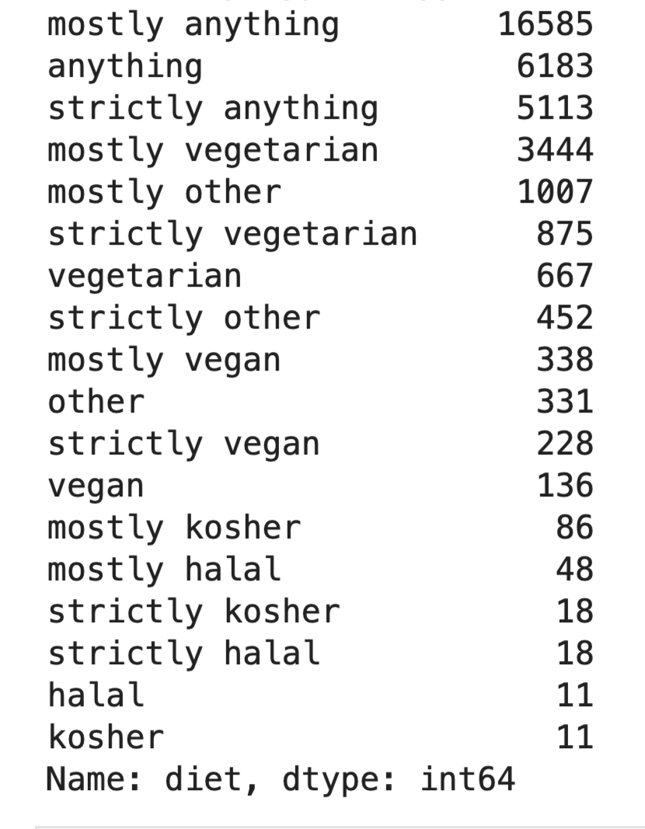
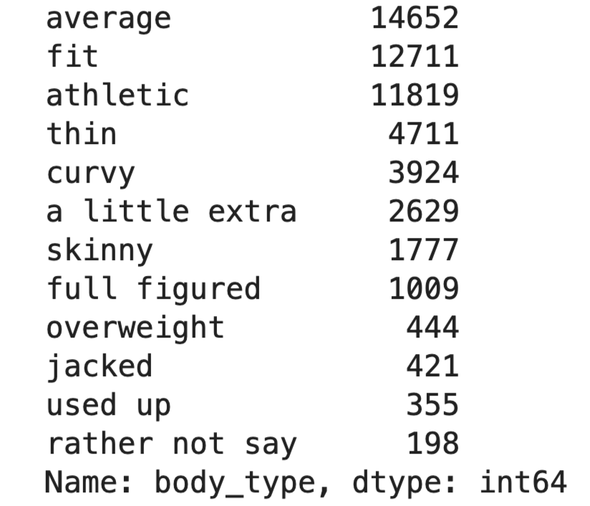
Exploration of Data
Labels
diet
Features
body_type

Slide 8
Sample Code: Data cleaning
'''Data Cleaning'''
# Drop all nas
df_clean.dropna(inplace=True)
# Remap age, diet, education, body_type and ethnicity to a few basic categories:
df_clean['diet'] = df_clean['diet'].apply(lambda x: 'anything' if 'anything' in str(x) else
('vegetarian' if 'vegetarian' in str(x) else
('vegan' if 'vegan' in str(x) else 'to drop')))
df_clean = df_clean[df_clean['diet'] != 'to drop'] # Eliminate everything outside of 'anything', 'vegeterian' and 'vegan'
df_clean['education'] = df_clean['education'].apply(lambda x:
'grad school' if 'ph.d' in str(x) or 'masters' in str(x) or
'medicine' in str(x) or 'law' in str(x) else # Counting medicine/law as grad school
('college' if 'college' in str(x) or 'university' in str(x) else
'highschool'))
# A Lambda comprehension method is not required when the values are more discrete:
df_clean['body_type'].replace({'jacked': 'athletic', 'fit': 'athletic', 'skinny': 'thin',
'curvy': 'slightly overweight', 'a little extra': 'slightly overweight',
'full figured': 'slightly overweight'},
inplace=True)
# Remove rows with less than 5% of the population and/or bring the number of possible responses to above five:
df_clean = df_clean[df_clean["body_type"] != "used up"] # Do not include the 'used up' body_type (it is ambiguous).
df_clean = df_clean[df_clean["body_type"] != "rather not say"] # This is effectively a null value.
# There are 211 ethnicities in the data
simple_ethnicities = ['white', 'asian', 'hispanic / latin', 'black', 'other']
# Condense them into five ethnicities:
df_clean = df_clean[df_clean['ethnicity'].isin(simple_ethnicities)]

Slide 9
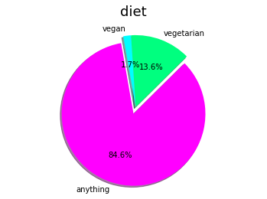
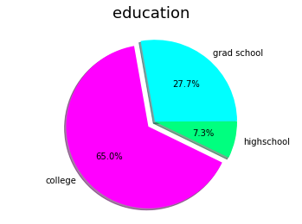
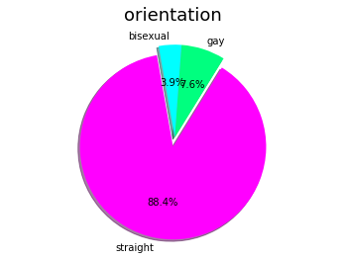
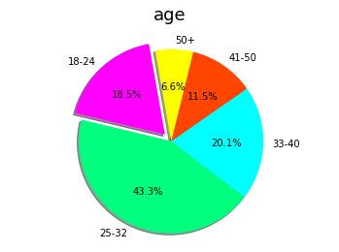
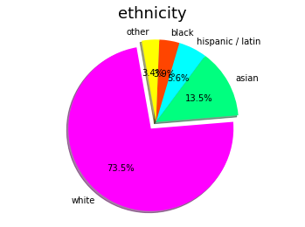
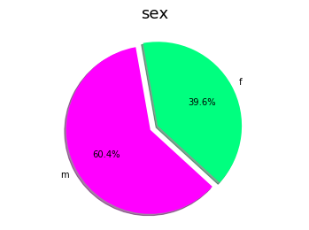
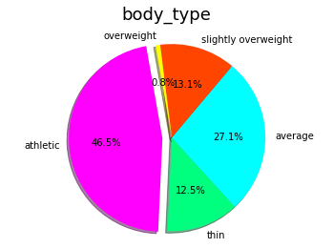
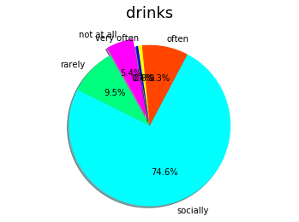

Slide 10
Sample Code: Pie chart generator
from matplotlib import pyplot as plt
def pie_charts_gen(df):
df_pie = df.copy() #Generate deepcopy for manipulation at will
columns = df_pie.columns.values
for column in columns: #Iterate through columns
if column == 'age': #Categorize ages into general intervals for ease of viewing
df_pie['age'] = df_pie['age'].apply(lambda x:
'18-24' if x > 17 and x < 25 else
('25-32' if x > 24 and x < 33 else
('33-40' if x > 32 and x < 41 else
('41-50' if x > 40 and x < 51 else '50+')))) counts = df_pie[column].value_counts().to_dict() #Count all values for respective column as a dictionary
# Order columns
if column == 'age':
desired_order = ['18-24', '25-32', '33-40', '41-50', '50+']
elif column == 'body_type':
desired_order = ['athletic', 'thin', 'average', 'slightly overweight', 'overweight'] #In order of body fat
elif column == 'diet':
desired_order = ['anything', 'vegetarian', 'vegan']
elif column == 'drinks':
desired_order = ['not at all', 'rarely', 'socially', 'often', 'very often', 'desperately']
elif column == 'education':
desired_order = ['college', 'highschool', 'grad school']
elif column == 'ethnicity':
desired_order = ['white', 'asian', 'hispanic / latin', 'black', 'other']
elif column == 'orientation':
desired_order = ['straight', 'gay', 'bisexual']
elif column == 'sex':
desired_order = ['m', 'f']
counts = {x: counts[x] for x in desired_order}

Slide 11
Sample Code: Pie chart generator
# Too few people are under 'desperately' to be counted
if column == 'drinks':
counts[''] = counts.pop('desperately')
labels = [key for key in counts.keys()]
sizes = [value for value in counts.values()]
colors = ['magenta', 'springgreen', 'cyan', 'orangered', 'yellow', 'b']
explode = tuple([0.1] + [0] * (len(counts)-1))
plt.pie(sizes, explode=explode, labels=labels, colors=colors,
autopct='%1.1f%%', shadow=True, startangle=100)
plt.title(column, pad=15, size=18)
plt.axis('equal')
plt.show()

Slide 12
Numeration of values
A considerable amount of bias is introduced when assigning numbers to a descriptive response of a user.
This is because any K-Nearest Neighbor (KNN) classifier will need to interpret a range of responses on the same scale.
For example, on a range from ‘athletic’ to ‘overweight’ as in the category “body_type”; the responses ‘thin’, ‘average’, and ‘slightly overweight’ must each be at specific intervals.
In this investigation, things are kept simple and items are simply labelled in chronological order, with no independent scoring based on the writer’s judgement i.e. each interval is equally spaced
'''Numerating Labels'''
df_cleaned_numerated = df_clean.replace({
'not at all': 0, 'rarely': 1, 'socially': 2, 'often': 3, 'very often': 4, 'desperately': 5, #drinks
'athletic': 0, 'thin': 1, 'average': 2, 'slightly overweight': 3, 'overweight': 4, # body_type
'anything': 0, 'vegetarian': 1, 'vegan': 2, # diet
'highschool': 0, 'college': 1, 'grad school': 2, #education
'white': 0, 'asian': 1, 'hispanic / latin': 2, 'black': 3, 'other': 4, #ethnicity
'straight': 0, 'bisexual': 1, 'gay': 2, #orientation
'm': 0, 'f': 1 #sex
})

Slide 13
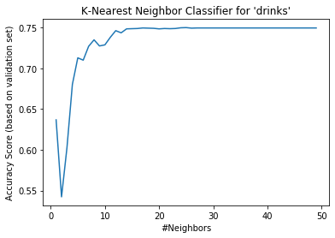
Elbow curve Validation analysis
The accuracy score of the classifier plateaus at around 15 neighbors.
Initially an accuracy score of 75% would look somewhat favorable.

Slide 14
Sample Code: Classifier Generator
from sklearn.neighbors import KNeighborsClassifier
from sklearn.model_selection import train_test_split
from sklearn.preprocessing import MinMaxScaler
def KNeighbors(features, labels): #Pass in two DataFrames, features and labels, both in numerical formats
#Preprocessing scaling
min_max_scaler = MinMaxScaler() #Call a scalar instance to weigh features equally
features_scaled = min_max_scaler.fit_transform(features) #Save result in a 'scaled' variable
#Data splitting
train_data, val_data, train_labels, val_labels = train_test_split(features_scaled, labels, test_size = 0.2, random_state = 100)
#Optimal #neighbors to accuracy analysis
accuracies = {}
accuracy_rating = {}
for i in range(1,50):
classifier = KNeighborsClassifier(n_neighbors=i)
classifier.fit(train_data, train_labels)
accuracies.update({i: classifier.score(val_data, val_labels)})
max_key = max(accuracies)
#Plot method
lists = sorted(accuracies.items()) # sorted by key (first value is k=1 and so on), return a list of tuples
x, y = zip(*lists) # unpack a list of pairs into two tuples
plt.plot(x, y)
plt.xlabel('#Neighbors')
plt.ylabel('Accuracy Score (based on validation set)')
plt.title("K-Nearest Neighbor Classifier for '" + labels.name + "'") # handily title the plot based on input
plt.show()

Slide 15
Sample Code: Classifier Generator
#Receive input for the optimal number of neighbors, should be based on elbow-curve validationa analysis:
user_num_neighbors = int(input('Choose optimal #neighbors:'))
#Perform fitting on the optimal classifier
best_classifier = KNeighborsClassifier(n_neighbors=user_num_neighbors)
best_classifier.fit(train_data, train_labels)
predicted_labels = best_classifier.predict(features_scaled)
#Return the prediction
return predicted_labels

Slide 16
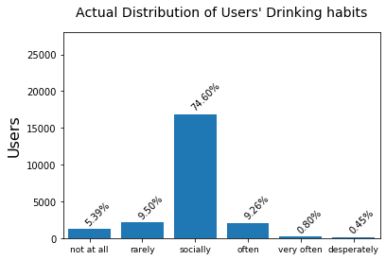
Actual
drinking habit distribution

Slide 17
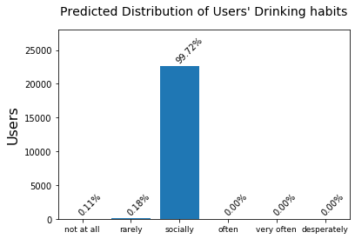
Predicted
drinking habit distribution

Slide 18
Unfortunately, the classifier has opted for the safe approach in selecting the mode response ‘socially’.
The accuracy would be ~75% as the original data is ~75% in this category.
Incorrect ~25%
Predicted
Correct ~75%
Actual

Slide 19
Sample Code: Distribution plots
import matplotlib.ticker as ticker
from matplotlib.ticker import AutoMinorLocator, FormatStrFormatter
# Method to annotate bars with percentage of total sample
def get_percentage(data, y_coord):
total = 0
for count in data.values():
total += count
percentage = (y_coord/total) * 100
return '{:0.2f}%'.format(percentage)
# Plot method
def plot_distributions(data, title):
plt.bar(data.keys(), list(data.values()), align='center')
ax = plt.gca() # Get axes
plt.xlim([-0.5, len(data)-0.5])
plt.ylim([0, 28000])
plt.title(title, size = 14, x = 0.5, y=1.05)
plt.ylabel('Users', labelpad=6, size=16)
plt.setp(ax.xaxis.get_minorticklabels(), rotation=350) # Rotate so that the labels don't overlap
ax.tick_params(axis='x', which='major', labelsize=9) # Remove the minor tick marks as they are unhelpful
for i in range(len(data)):
x_coord = i-0.1
y_coord = list(data.values())[i]
annotation = get_percentage(data, y_coord)
plt.annotate(annotation, (x_coord, y_coord + 500), rotation=45)
plt.show()

Slide 20
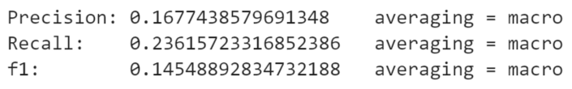
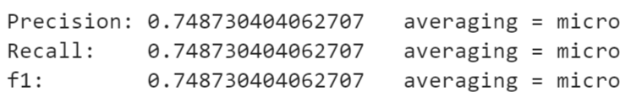
Precision, recall, f1
Multilabel classification
The problem can be more easily identified by calling an F1 score.
Macro averaging where every class is counted equally shows how bad the classifier really is.
Micro averaging, including class weight, results in a repeat of the accuracy (the total false positives and the total false negatives are both 25).
Macro
Micro
Features

Slide 21
Sample Code: PRF1 Analysis
from sklearn.metrics import accuracy_score, recall_score, precision_score, f1_score
print('Precision:',
precision_score(predicted_drinkinghabits, true_drinkinghabits,
labels=[0,1,2,3,4,5],
average='macro', zero_division='warn'),
' averaging = macro')
'''
This is the same score as the accuracy when changed to MICRO averaging.
100% of the predicted data exists within the 'social' class label, so the precision score is
entirely based off of the precision for one class.
If the total true positives (number of times the classifier correctly guessed 'social'), was 75,
then the total false positives (number of times the classifier incorrectly guessed 'social') would be 25. Making the same value as accuracy.
'''
print('Recall: ',
recall_score(predicted_drinkinghabits, true_drinkinghabits,
labels=[0,1,2,3,4,5],
average='micro', zero_division='warn'),
' averaging = macro')
'''
Recall is the same as accuracy when changed to MICRO averaging because the total false negatives is 25,
where each class other than 'socially' would contain the 25% of remaining samples after classification.
The classifier placed 0 samples within these other classes, therefore they are counted as false negatives (incorreclty
labelled as 'socially') and the total false negatives is 25.
'''
print('f1: ',
f1_score(predicted_drinkinghabits, true_drinkinghabits,
average='macro'),
' averaging = macro')

Slide 22
A new question: Predictive Gender
Our current tools are struggling with predicting drinking habits. The correlation appears weak and exacerbated by the high number of ‘drink socially’ responses, where this is a general answer that could have been split into several of its own categories.
One obvious class with a relatively balanced class distribution is gender. We will therefore predict gender based on the same features selected for predicting drinking habits.

Slide 23
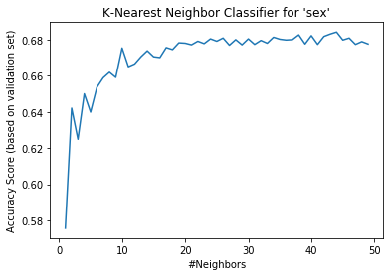
Elbow curve Validation analysis
The accuracy score of the classifier plateaus at around 20 members (debatable)

Slide 24
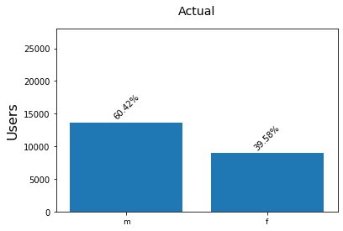
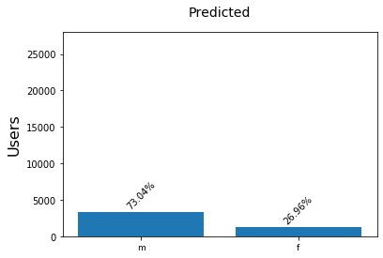
A new question: Predictive Gender

Slide 25
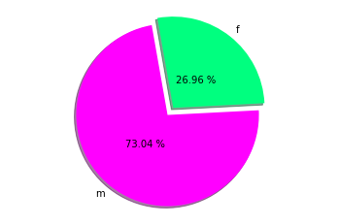
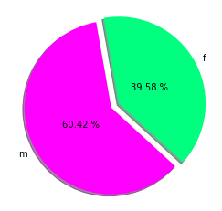
A new question: Predictive Gender
Actual
Predicted

Slide 26
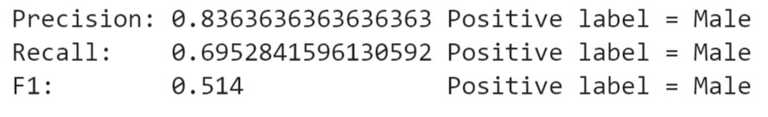
Precision, recall, f1
Binary classification
With an accuracy of around 68%, PRF analysis highlights good precision when using males as the positive class.
As a generalization the classifier is decent in terms of predicting a male gender and less so for female.
Features
All methods from the previous problem have been reused for a fair comparison

Slide 27
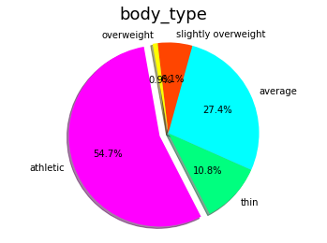
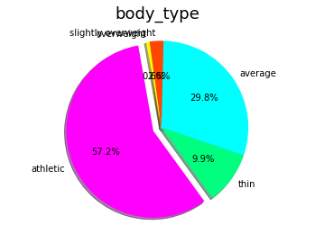
Trait Correlation
By eye there are a couple of traits which appear to have some potential for predicting gender.
These being whether one describes themselves as ‘athletic’ (male dominated response) or ‘vegetarian’ or ‘vegan’ (female dominated trait).
By finding the index labels of the individuals predicted as male and female by the classifier, we can form separate data-frames of all the samples predicted as male and female, respectively.
These data-frames can then be compared with the actual data-frames for the actual male samples and the actual female samples:
Actual male
body types
Predicted male body types

